Slide 1

Network Diagram & Heat Map
Caleb Raftelis

Slide 2
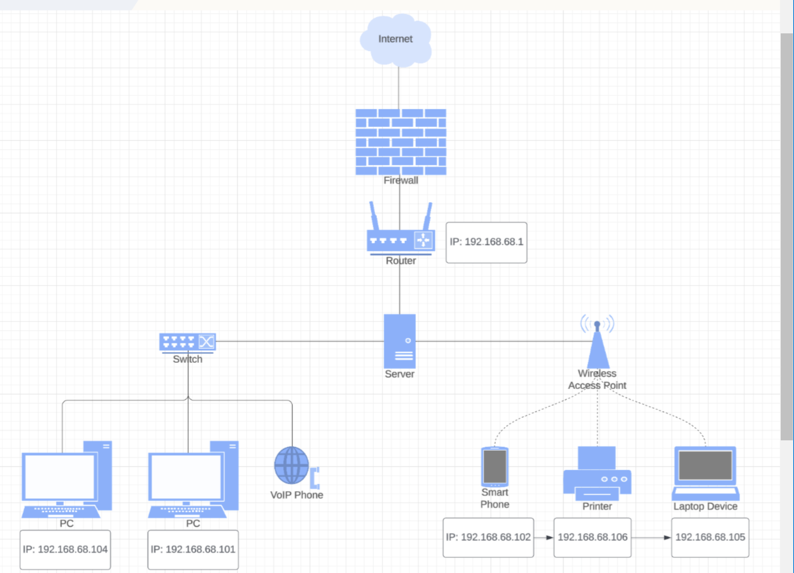
Network Diagram
someone@example.com

Slide 3
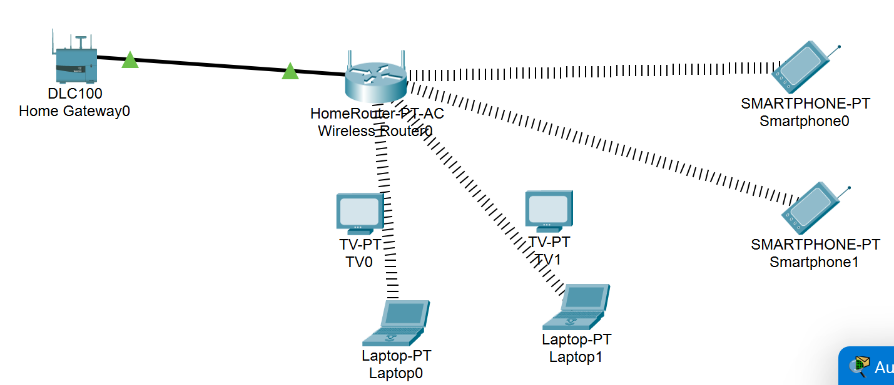
Cisco Packet tracer diagram

Slide 4
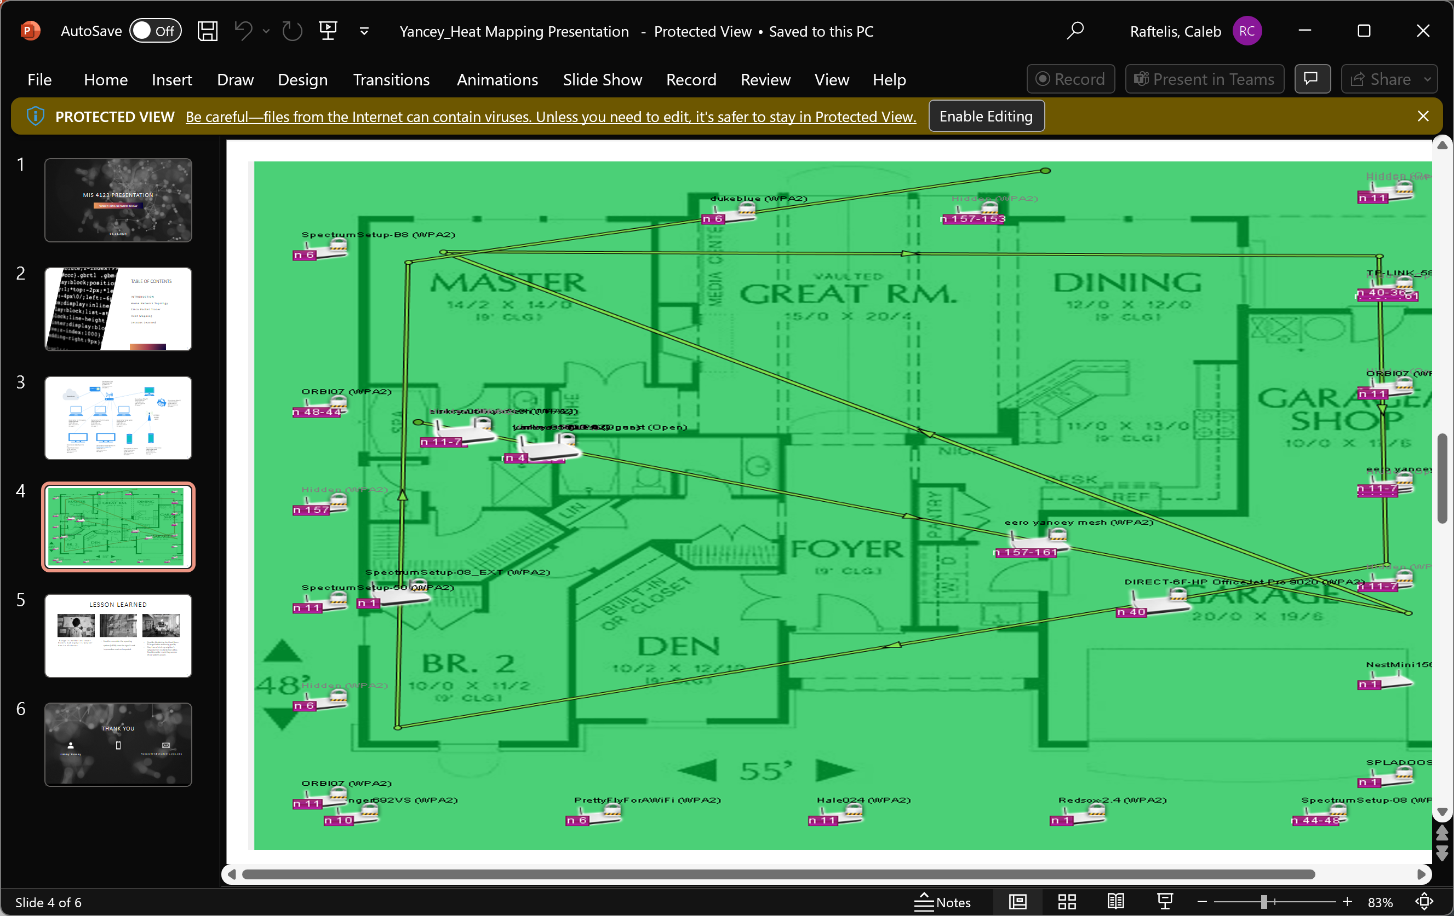
Heat map
Small 2-bedroom house with both router and access point also, Wi-Fi extension in the other bedroom

